Slide 1
async/await and asyncio in Python 3.6 and beyond
Yury Selivanov @1st1 y@magic.io
PyCon US 2017

Slide 2
About me
Core developer since 2013
PEPs: 362, 492, 525, 530
asyncio/uvloop/asyncpg
MagicStack -> magic.io

Slide 3
Let’s talk about
async/await.

Slide 4
Why async/await?
Other Ways
threads;
callbacks / promises;
gevent / eventlet / stackless;
generators with ‘yield from’.

Slide 5
Why async/await?
Readability
Better than callbacks or Promises;
Easier to reason about than with
threads or gevent code;
Promotes better patterns:
message passing.

Slide 6


Why async/await?
Multithreading
Theory
Practice

Slide 7
Why async/await?
Efficiency
No threads: no GIL problem;
Less memory per connection;
Can handle thousands of long
lasting connections.

Slide 8
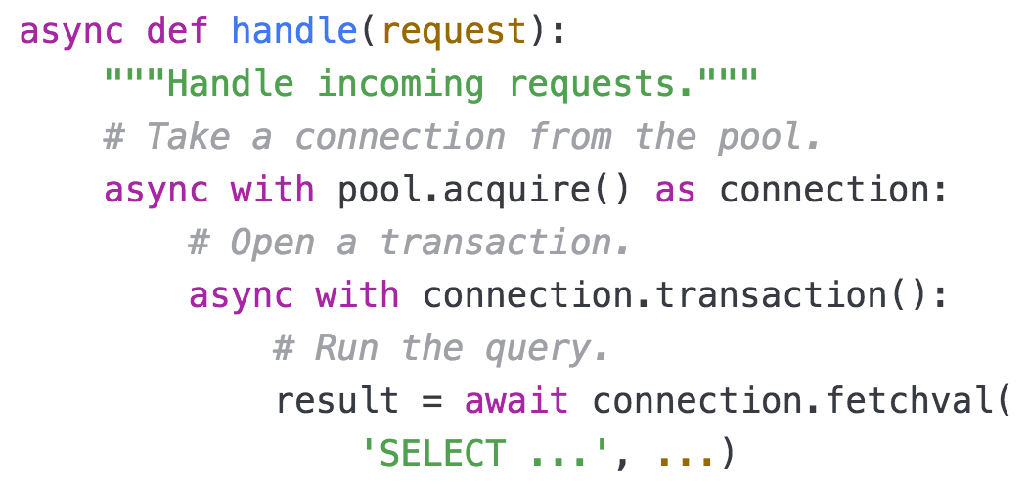
What is async/await?
Syntax: new in 3.5

Slide 9
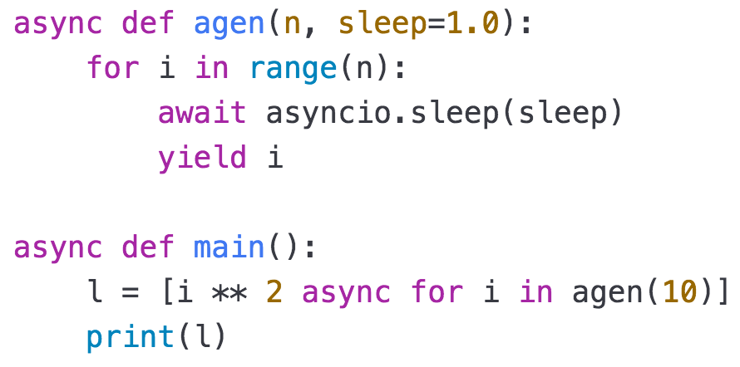
What is async/await?
Syntax: new in 3.6

Slide 10
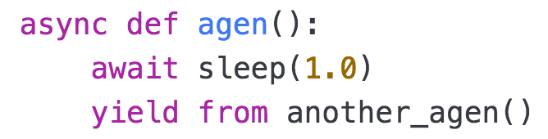
What is async/await?
Syntax: 3.7 (maybe)

Slide 11
What is async/await?
Protocol
Based on iterator protocol;
__await__;
__aiter__, __anext__;
__aenter__, __aexit__.

Slide 12
How to async/await?
Frameworks
Application
Application Framework
Async Framework
Python Interpreter
OS

Slide 13
How to async/await?
Twisted and Tornado
Twisted is the mother of async in
Python;
both own big ecosystems and
mindshare;
can/will run on top of asyncio.

Slide 14
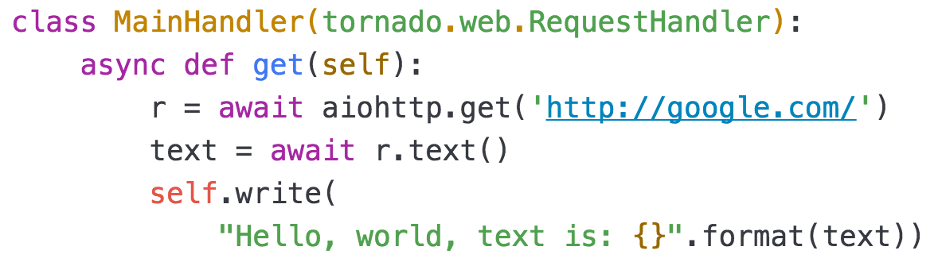
How to async/await?
Twisted and Tornado

Slide 15
How to async/await?
Curio and Trio
explore new approaches;
(influence asyncio)
make async easier to use;
not mainstream.

Slide 16
Let’s talk about asyncio.

Slide 17
What is asyncio?
Foundation
low-level APIs;
async/await;
here to stay;
pluggable event loop.

Slide 18
What is asyncio?
Low-level APIs
callbacks;
Transports and Protocols;
network, subprocesses, signals.

Slide 19
What is asyncio?
async/await
run coroutines;
streams, sockets, subprocesses,
locks, timeouts.

Slide 20
What is asyncio?
Mainstream
stable and forever supported;
healthy ecosystem;
HTTP: aiohttp and Sanic;
DBs: asyncpg, aio-libs, etc.

Slide 21
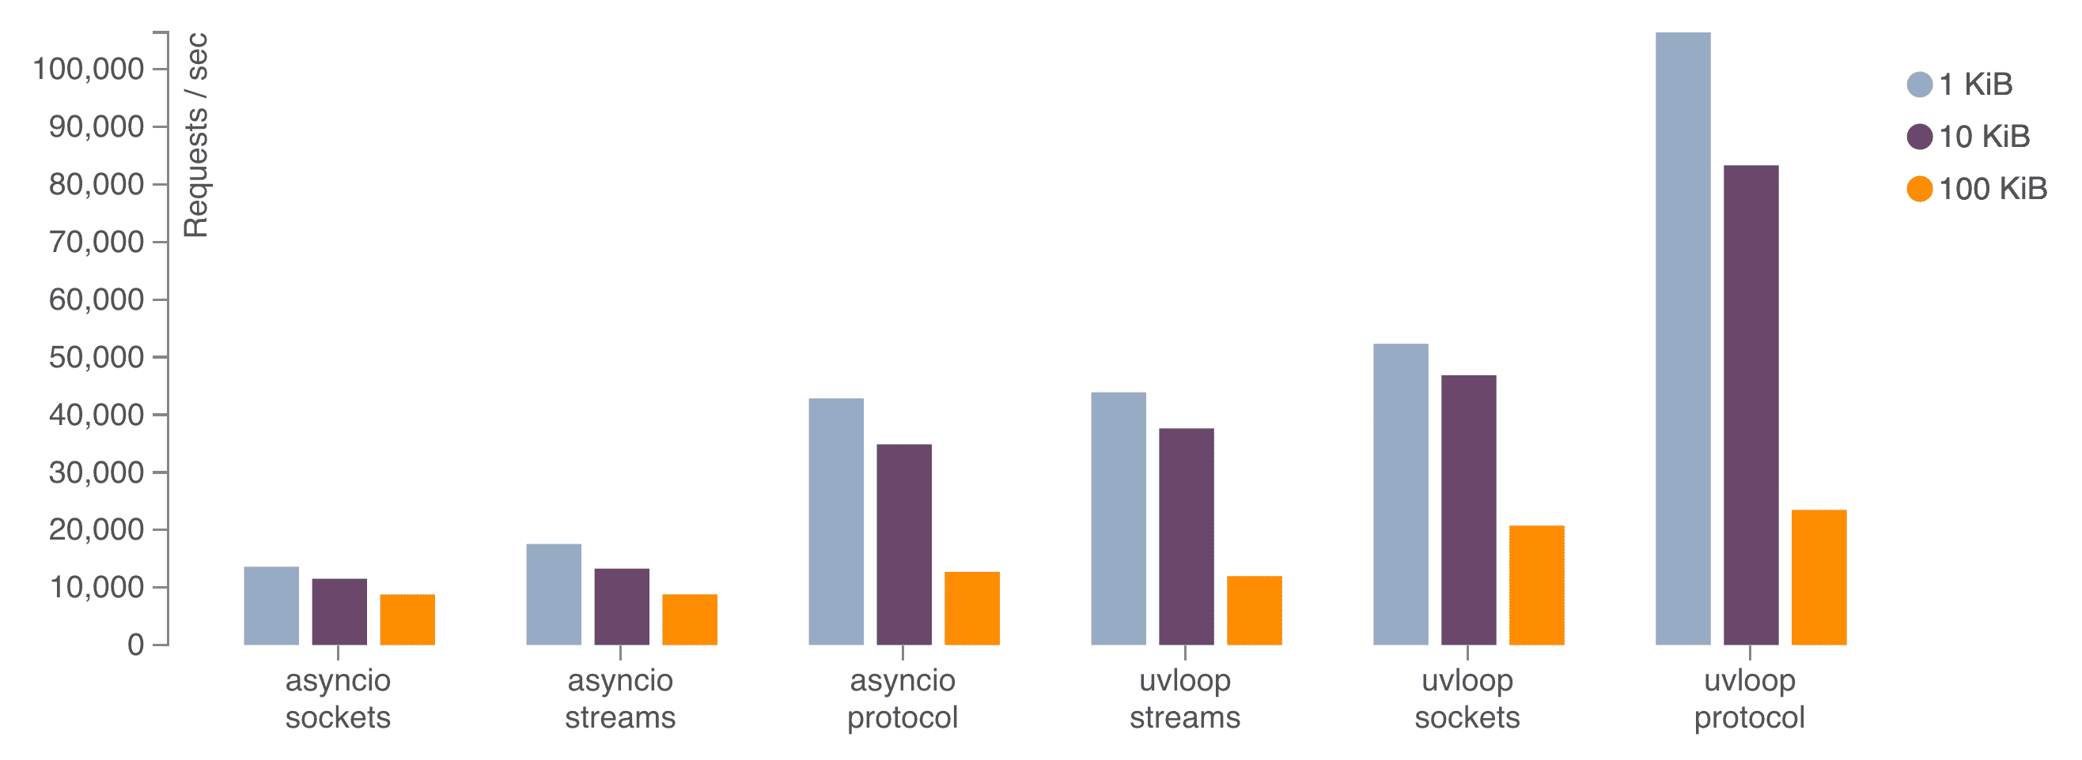
What is asyncio?
Pluggable event loop
uvloop: make asyncio 2-4 times faster.

Slide 22
PyO
3

Slide 23
What is asyncio?
Pluggable event loop
github.com/pyo3: Tokio;
Rust meets Python;
incomplete and experimental;
aims for safety and performance.

Slide 24
What’s next for asyncio?

Slide 25
What’s next?
Goals for 3.7
run/use Twisted on/in asyncio;
maybe curio and trio can
be (re-)built on top of asyncio?
that Rust loop…

Slide 26
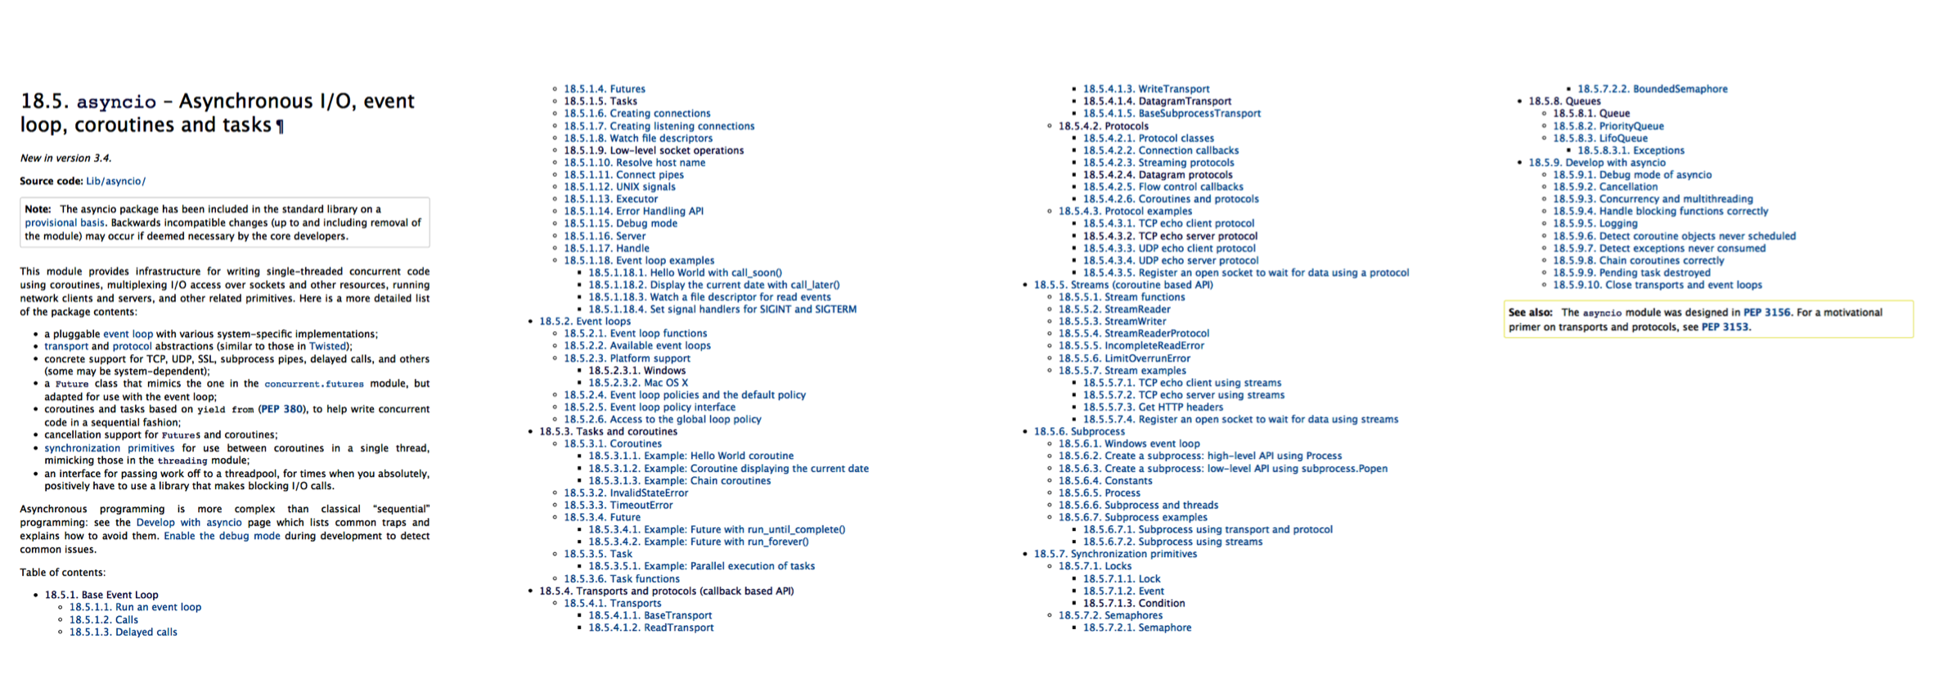
What’s next?
Usability
Documentation overhaul in 3.7

Slide 27
What’s next?
Usability: now
asyncio.get_event_loop()
loop.create_task()
loop.run_until_complete()
loop.run_forever()
asyncio.gather()
loop.run_in_executor()

Slide 28
What’s next?
Usability: now
pass event loop explicitly
asyncio.get_event_loop()
in Python 3.6 is predictable
in async functions

Slide 29
What’s next?
Usability: in 3.7?
asyncio.get_event_loop()
loop.create_task()
loop.run_until_complete()
loop.run_forever()
asyncio.gather()
loop.run_in_executor()

Slide 30
What’s next?
More New Things?
start_tls()
Call / Task Context
async REPL

Slide 31
What’s next?
We Need Your Help
Ask for new features!
bugs.python.org
python-tulip mailing list
GitHub!

Slide 32
Thank you!

